Slide 1
Unite 5
The money game
————highlighter

Slide 2
Word list
Manipulate
Contradict Paradox Odds
Perspective
Disguise
Utmost
Explicit
Stock
Consult

Slide 3
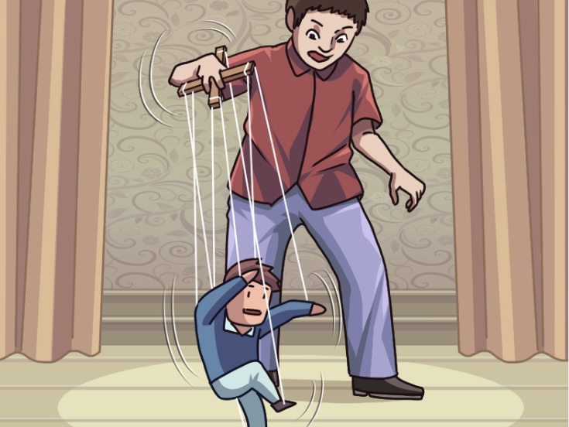
manipulate
The man on the stage expertly manipulates the puppets using strings.
舞台上这个男人熟练地用线操纵木偶
Manipulate vt. 操纵，控制（某人思想和行为）

Slide 4
The word discrimination
Contradict Paradox Odds
与·矛盾；违背
自行矛盾（的情况）
(与某物）不一致，相矛盾
Contradiction——是矛盾、对立的意思,在逻辑上,要么是A要么是B,不可能既是A又是B,即为非此即彼。
Paradox——则是“似是而非”,含有诡辩的意味,有时令人难以厘清。
Odds——偏向于物品之间的差异，也含有概率的意思。

Slide 5

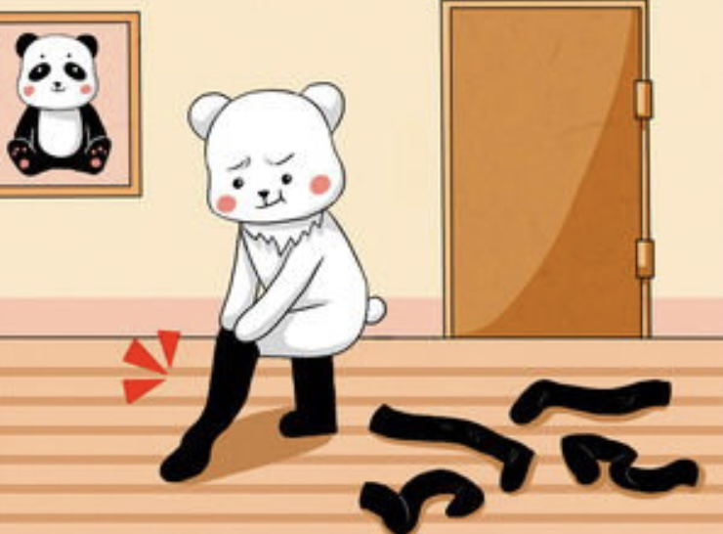


Line the words with pictures
Disguise
Explicit
Stock
Consult

Slide 6
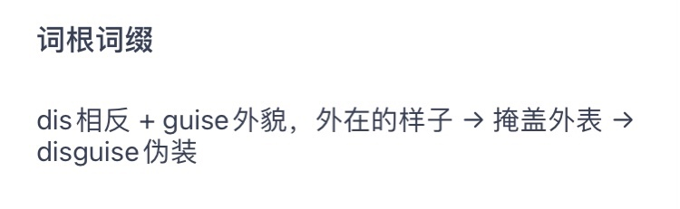
Miss Bear disguised herself as a panda by wearing black stockings.
Disguise
vt. Change one ’s appearance so that people cannot recognize him 装扮；假扮

Slide 7
The map shows an explicit route to me.
Explicit
a. Expressed in a way that is very clear and direct 清楚明确的；直截了当的
Vocabulary upgraded
Clear
Explicit

Slide 8
Recently, many people lost a lot of money in the stock market.
Phrase
Take stock (of sth.) think carefully about the things that have happened in a situation in order to decide what to do next (对形势） 作出估计（判断）
Stock
n.
1 an amount of sth. That you keep so that you can use it when you need it 储备；储备物
2 One of the equal parts into which the value of a company is divided 股份

Slide 9
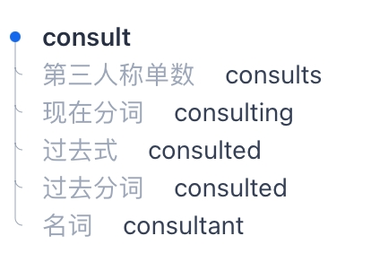
The consultant will explain how we should run our business.
Consult v. Ask for information or advice from sb. Who has special knowledge about a particular subject 咨询；请教

Slide 10

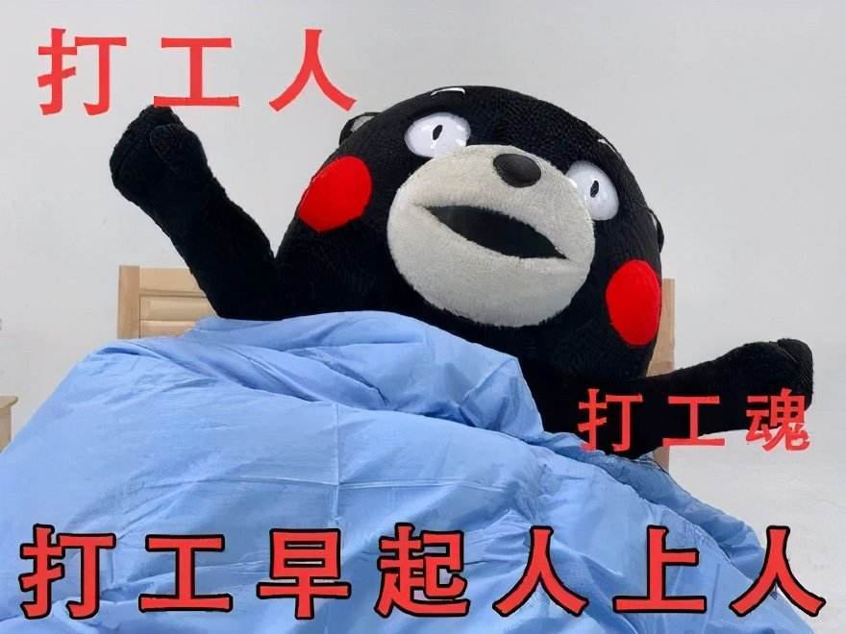
Perspective
n.[C]（思考问题的）角度，观点
Utmost
n.极度；极限；最大可能
I hope that we can face problems from multiple perspectives in college and do our utmost to overcome difficulties！

Slide 11
Word review
Manipulate vt. 操纵，控制（某人思想和行为）
Contradict v. 与·相抵触；与·矛盾；违背
Paradox n. [C]自行矛盾（的情况）
Odds n.[pl.](与某物）不一致，相矛盾
Perspective n.[C]（思考问题的）角度，观点
Disguise vt.装扮；假扮
Utmost n.极度；极限；最大可能
Explicit a.清楚明确的；直截了当的
Stock n.1储备，储备物 2股份
Consult v.咨询；请教

Slide 12
Thank you！

